Slide 1

Twitter Recommender System
Team 7: Seth Lanza, Kyle Kauffman, Sophia Liu, Emma Minnick

Slide 2
Introduction
Twitter’s algorithm sorts through roughly 500 million tweets posted daily to come up with recommendations for users
Recommends searches, ads, and content for “For You” feed
Uses candidate sourcing, a ML model to rank tweets, and applies heuristics and filters to sort through content
Notes:
3 steps :
Fetch the best Tweets from different recommendation sources in a process called candidate sourcing.
Rank each Tweet using a machine learning model.
Apply heuristics and filters, such as filtering out Tweets from users you’ve blocked, NSFW content, and Tweets you’ve already seen.

Slide 3
Candidate Sourcing
Used to retrieve recent and relevant tweets for users
Attempt to extract the best 1500 tweets from hundreds of millions through sources
Assesses in-network (people you follow) and out-of-network (people you don’t follow), which ends up being about 50/50
In-network uses logistic regression model to rank tweets based on relevance
Real graph predicts the likelihood of engagement between two users– higher the Real Graph score the more of their tweets we’ll include
Embedding spaces are biggest source of out-of-network tweets, using numerical representations of users’ interests and content (SimClusters)

Slide 4
Ranking
1500 tweets produced in the pipeline that may be relevant
Achieved with a neural network that is continually trained based on Tweet interactions (likes, retweets, replies)
Gives tweets scores representing probability of engagement and then produces ranking

Slide 5
Heuristics and Filters
Visibility: remove tweets from accounts you block or mute
Author Diversity: avoid too many consecutive tweets from single author
Content Balance: balance of in-network and out-of-network
Feedback-based Fatigue: lower score if user has provided negative feedback about it
Social Proof: ensure someone engaged with tweet or follows author
Conversations: providing more context based on replies to original tweets
Edited Tweets: replace old tweets with edited versions

Slide 6
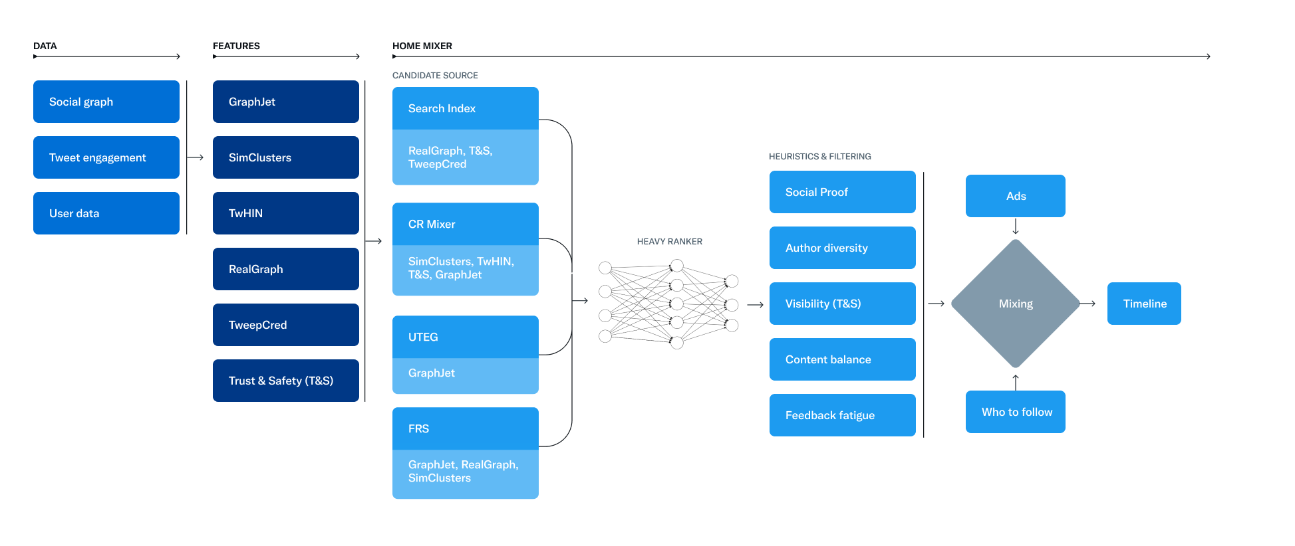

Slide 7
“SimClusters: Community-Based Representations for Heterogeneous Recommendations at Twitter”
SimClusters: overlapping communities that capture user, topics, ads, etc.
Stage 1: Community Discovery
Stage 2: Item Representations
Each community characterized by “influencer” that people follow
Sparse, interpretable vectors
Cosine similarity is key
Able to scale to Twitter's some 450 million users
Deployment tactics different for uses cases with different latency

Slide 8
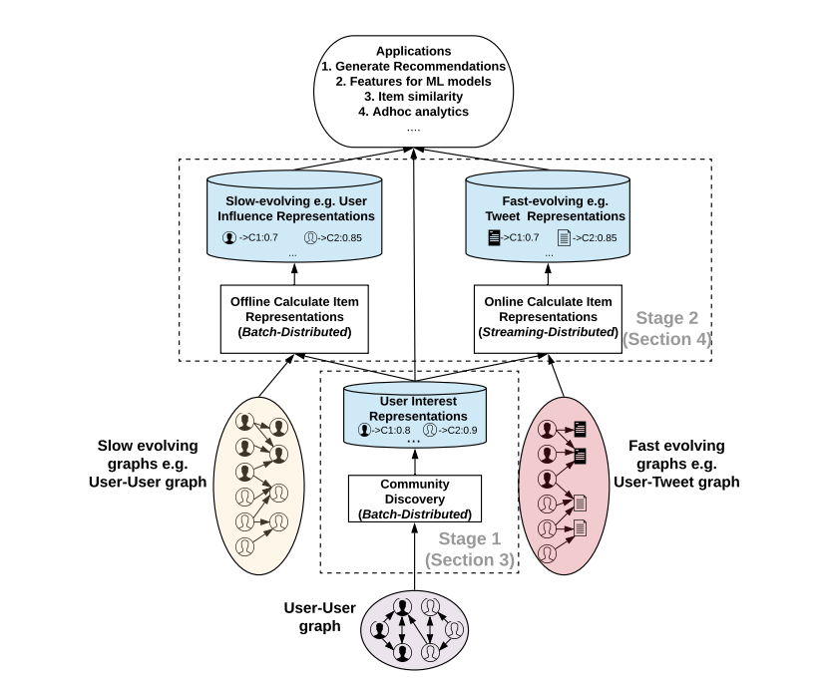
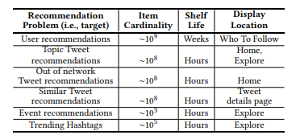

Slide 9
SimCluster Evaluation
Goal of Twitter's recommendation systems: "to make content discovery effortless and to free the user from the need of manual creation."
Has only been in production for ~ 3 years
Similar tweets recommendation: +33% user engagement
Centralized recommendations system that tackles multiple problems
One master algorithm may increase risk of high-impact ethical concerns

Slide 10
Open Source Code Walkthrough
We passed the scala code through ChatGPT to convert it to python so it would be easier to follow, though the original is linked below.
https://github.com/twitter/the-algorithm/blob/main/simclusters-ann/server/src/main/scala/com/twitter/simclustersann/candidate_source/SimClustersANNCandidateSource.scala

Slide 11
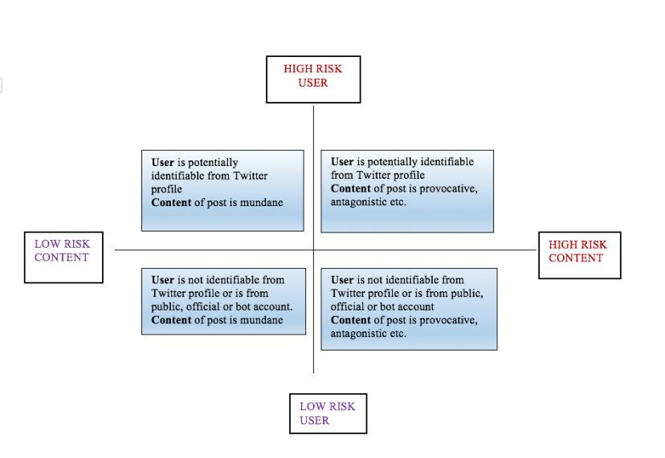
Ethical concerns
Algorithmic bias
Privacy
Transparency
Manipulation
User empowerment
Media literacy

Slide 12
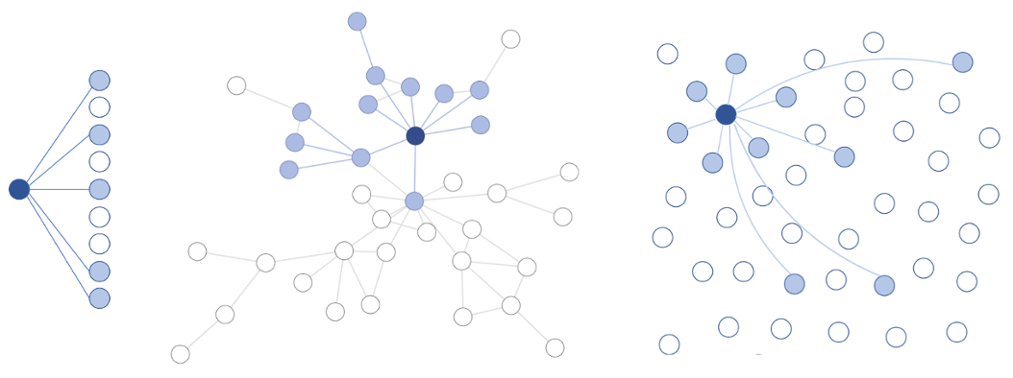
What’s Next
Trade-off
Concerns about Exploration vs Exploitation
The Information Cocoon
Security of Twitter on the Back-end
User data is secure
Protected from unauthorized access

Slide 13
Research Citations
Twitter, Venu Satuluri, et al. “Simclusters: Proceedings of the 26th ACM SIGKDD International Conference on Knowledge Discovery & Data Mining.” ACM Conferences, 1 Aug. 2020, https://dl.acm.org/doi/pdf/10.1145/3394486.3403370.
PyTorch. (n.d.). PyTorch. Retrieved April 4, 2023, from https://pytorch.org/
TensorFlow. (n.d.). TensorFlow. Retrieved April 4, 2023, from https://www.tensorflow.org/
Twitter Engineering. (2023, March 31). Twitter Recommendation Algorithm. Twitter Engineering. https://blog.twitter.com/engineering/en_us/topics/open-source/2023/twitter-recommendation-algorithm
Huang, Z., Chen, X., Wang, C., Zhang, J., Wang, X., & Liu, T. (2020). Online Learning Framework for Mobile Personalized Recommendation. Proceedings of the 28th ACM International Conference on Information and Knowledge Management, 1649-1658. https://doi.org/10.1145/3394486.3403370
Fiesler, C., & Proferes, N. (2018). The ethical challenges of publishing Twitter data for research dissemination. Journal of Empirical Research on Human Research Ethics, 13(3), 302-312. https://doi.org/10.1177/1556264618769087

